Slide 1
Closing Notes
Amos Azaria

Slide 2
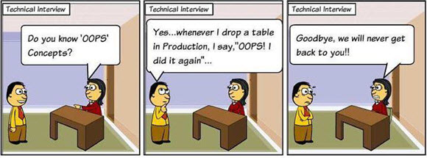
What we've learned…
I believe that we have learned a lot in this course.
The material we leaned is essential knowledge for any software developer.

Slide 3

Databases and Data!
While most of the other universities focus merely on standard relational database management system, we have learned, in addition, a lot about data in general.
I hope that you have enjoyed the course!

Slide 4
Follow-up Courses
If you have enjoyed the last few lessons (machine learning) you may be interested in:
taking my own course about deep learning and NLP (given in the first semester).
taking Larry's course in Neural Computation.
taking Liad's course on Machine learning (given in the second semester).
I'll also be happy to advise you for your final project, or if you would like to continue on to a master's degree.
If you have enjoyed the part about big-data (NoSQL / Spark etc.), you may be interested in taking the big-data course.
There also is a course in image processing.

Slide 5
Thank you and good luck on all your exams!

